Slide 1
What is Dynamic Programming?
Dynamic programming solves optimization problems by combining solutions to subproblems
“Programming” refers to a tabular method with a series of choices, not “coding”
Matrix Chain Multiplication

Slide 2
What is Dynamic Programming? …contd
A set of choices must be made to arrive at an optimal solution
As choices are made, subproblems of the same form arise frequently
The key is to store the solutions of subproblems to be reused in the future
Matrix Chain Multiplication

Slide 3
What is Dynamic Programming? …contd
Recall the divide-and-conquer approach
  Partition the problem into independent subproblems
  Solve the subproblems recursively
  Combine solutions of subproblems
This contrasts with the dynamic programming approach
Matrix Chain Multiplication

Slide 4
What is Dynamic Programming? …contd
Dynamic programming is applicable when subproblems are not independent
  i.e., subproblems share subsubproblems
  Solve every subsubproblem only once and store the answer for use when it reappears
A divide-and-conquer approach will do more work than necessary
Matrix Chain Multiplication

Slide 5
A Sequence of 4 Steps
A dynamic programming approach consists of a sequence of 4 steps
  Characterize the structure of an optimal solution
  Recursively define the value of an optimal solution
  Compute the value of an optimal solution in a bottom-up fashion
  Construct an optimal solution from computed information
Matrix Chain Multiplication

Slide 6
Matrix-chain Multiplication
Suppose we have a sequence or chain A₁, A₂, …, A_{n} of n matrices to be multiplied
  That is, we want to compute the product A₁A₂…A_{n}
There are many possible ways (parenthesizations) to compute the product
Matrix Chain Multiplication

Slide 7
Matrix-chain Multiplication …contd
Example: consider the chain A₁, A₂, A₃, A₄ of 4 matrices
  Let us compute the product A₁A₂A₃A₄
There are 5 possible ways:
  (A₁(A₂(A₃A₄)))
  (A₁((A₂A₃)A₄))
  ((A₁A₂)(A₃A₄))
  ((A₁(A₂A₃))A₄)
  (((A₁A₂)A₃)A₄)
Matrix Chain Multiplication

Slide 8
Matrix-chain Multiplication …contd
To compute the number of scalar multiplications necessary, we must know:
  Algorithm to multiply two matrices
  Matrix dimensions
Can you write the algorithm to multiply two matrices?
Matrix Chain Multiplication

Slide 9
Algorithm to Multiply 2 Matrices
Input: Matrices A_{p×q} and B_{q×r} (with dimensions p×q and q×r)
Result: Matrix C_{p×r} resulting from the product A·B
MATRIX-MULTIPLY(A_{p×q} , B_{q×r})
1. for i ← 1 to p
2. for j ← 1 to r
3. C[i, j] ← 0
4. for k ← 1 to q
5. C[i, j] ← C[i, j] + A[i, k] · B[k, j]
6. return C
Scalar multiplication in line 5 dominates time to compute C
Number of scalar multiplications = pqr
Matrix Chain Multiplication

Slide 10
Matrix-chain Multiplication …contd
Example: Consider three matrices A_{10×100}, B_{100×5}, and C_{5×50}
There are 2 ways to parenthesize
  ((AB)C) = D_{10×5} · C_{5×50}
    AB ⇒ 10·100·5=5,000 scalar multiplications
    DC ⇒ 10·5·50 =2,500 scalar multiplications
  (A(BC)) = A_{10×100} · E_{100×50}
    BC ⇒ 100·5·50=25,000 scalar multiplications
    AE ⇒ 10·100·50 =50,000 scalar multiplications
Total: 7,500
Total: 75,000
Matrix Chain Multiplication

Slide 11
Matrix-chain Multiplication …contd
Matrix-chain multiplication problem
  Given a chain A₁, A₂, …, A_{n} of n matrices, where for i=1, 2, …, n, matrix A_{i} has dimension p_{i-1}×p_{i}
  Parenthesize the product A₁A₂…A_{n} such that the total number of scalar multiplications is minimized
Brute force method of exhaustive search takes time exponential in n
Matrix Chain Multiplication

Slide 12
Dynamic Programming Approach
The structure of an optimal solution
  Let us use the notation A_{i..j} for the matrix that results from the product A_{i} A_{i+1} … A_{j}
  An optimal parenthesization of the product A₁A₂…A_{n} splits the product between A_{k} and A_{k+1} for some integer k where1 ≤ k < n
  First compute matrices A_{1..k} and A_{k+1..n} ; then multiply them to get the final matrix A_{1..n}
Matrix Chain Multiplication

Slide 13
Dynamic Programming Approach …contd
  Key observation: parenthesizations of the subchains A₁A₂…A_{k} and A_{k+1}A_{k+2}…A_{n} must also be optimal if the parenthesization of the chain A₁A₂…A_{n} is optimal (why?)
  That is, the optimal solution to the problem contains within it the optimal solution to subproblems
Matrix Chain Multiplication

Slide 14
Dynamic Programming Approach …contd
Recursive definition of the value of an optimal solution
  Let m[i, j] be the minimum number of scalar multiplications necessary to compute A_{i..j}
  Minimum cost to compute A_{1..n} is m[1, n]
  Suppose the optimal parenthesization of A_{i..j} splits the product between A_{k} and A_{k+1} for some integer k where i ≤ k < j
Matrix Chain Multiplication

Slide 15
Dynamic Programming Approach …contd
  A_{i..j} = (A_{i} A_{i+1}…A_{k})·(A_{k+1}A_{k+2}…A_{j})= A_{i..k} · A_{k+1..j}
  Cost of computing A_{i..j} = cost of computing A_{i..k} + cost of computing A_{k+1..j} + cost of multiplying A_{i..k} and A_{k+1..j}
  Cost of multiplying A_{i..k} and A_{k+1..j} is p_{i-1}p_{k} p_{j}
  m[i, j ] = m[i, k] + m[k+1, j ] + p_{i-1}p_{k} p_{j} for i ≤ k < j
  m[i, i ] = 0 for i=1,2,…,n
Matrix Chain Multiplication

Slide 16
Dynamic Programming Approach …contd
  But… optimal parenthesization occurs at one value of k among all possible i ≤ k < j
  Check all these and select the best one
0 if i=j
m[i, j ] =
min {m[i, k] + m[k+1, j ] + p_{i-1}p_{k} p_{j} } if i<j
i ≤ k< j
Matrix Chain Multiplication

Slide 17
Dynamic Programming Approach …contd
To keep track of how to construct an optimal solution, we use a table s
s[i, j ] = value of k at which A_{i} A_{i+1} … A_{j} is split for optimal parenthesization
Algorithm: next slide
  First computes costs for chains of length l=1
  Then for chains of length l=2,3, … and so on
  Computes the optimal cost bottom-up
Matrix Chain Multiplication

Slide 18
Algorithm to Compute Optimal Cost
Input: Array p[0…n] containing matrix dimensions and n
Result: Minimum-cost table m and split table s
MATRIX-CHAIN-ORDER(p[ ], n)
for i ← 1 to n
m[i, i] ← 0
for l ← 2 to n
for i ← 1 to n-l+1
j ← i+l-1
m[i, j] ← ∞
for k ← i to j-1
q ← m[i, k] + m[k+1, j] + p[i-1] p[k] p[j]
if q < m[i, j]
m[i, j] ← q
s[i, j] ← k
  return m and s
Takes O(n³) time
Requires O(n²) space
Matrix Chain Multiplication

Slide 19
Constructing Optimal Solution
Our algorithm computes the minimum-cost table m and the split table s
The optimal solution can be constructed from the split table s
  Each entry s[i, j ]=k shows where to split the product A_{i} A_{i+1} … A_{j} for the minimum cost
Matrix Chain Multiplication

Slide 20

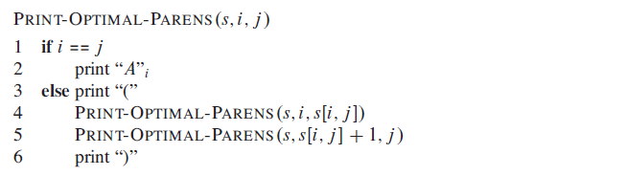
Algorithm: Constructing Optimal Solution
Matrix Chain Multiplication

Slide 21
Example
Show how to multiply this matrix chain optimally
Solution on the board
  Minimum cost 15,125
  Optimal parenthesization ((A₁(A₂A₃))((A₄ A₅)A₆))
Matrix | Dimension
A₁ | 30×35
A₂ | 35×15
A₃ | 15×5
A₄ | 5×10
A₅ | 10×20
A₆ | 20×25
Matrix Chain Multiplication

Slide 22
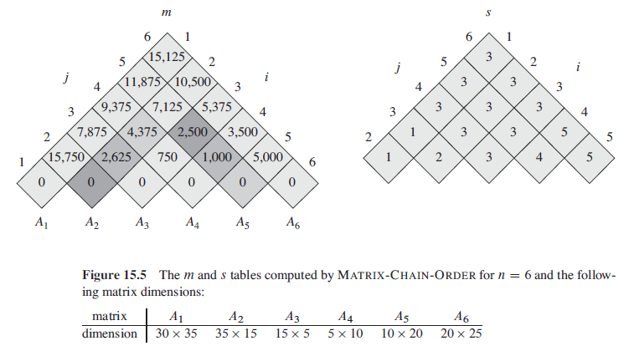
Result
Matrix Chain Multiplication

Slide 23
Elements of Dynamic Programming
For dynamic programming to be applicable, an optimization problem must have:
Optimal substructure
  An optimal solution to the problem contains within it optimal solution to subproblems (but this may also mean a greedy strategy applies)
Overlapping subproblems
  The space of subproblems must be small; i.e., the same subproblems are encountered over and over
Matrix Chain Multiplication

